Slide 1
Telecommunication Management Database System
INFO 5707 Section 005: Data Modeling for Information Professionals
Kamini Suresh Yelamar

Slide 2
Introduction
The Telecommunication Management Network (TMN) a supporting entity and framework activities associated with operating telecommunications networks and services
The TMDS system can be used by various stakeholders in the organization, including IT managers, network administrators, and financial managers.
In this digital age where communication plays a vital role in organizational success, a TMDS system is essential for managing telecommunication operations effectively.

Slide 3
Objective and Scope
The Telecommunication management system is designed to operate/manage customer’s telecom services.
Aiming to create a database system which will contain tables for customer details, device, opted service/plan (Prepaid and postpaid), offer, Usage (Data, voice, and SMS), complaints reported (feedback), billing cycle, invoice, payment, employee (Customer representative), department.
This system will contain multiple Relational Tables for above mentioned details that will provide a comprehensive view of a customer representative's operations, which allows them to manage their network and service efficiently.
The system will also include a blacklist option for customers with overdue payments of more than three months.
Each customer will be billed according to the chosen plan and usage (in case of postpaid).
Once the bill is calculated, invoices will be generated and notified to the customer. So that, customer can make a payment for the invoice.

Slide 4
User Requirements
Customers should be able to view their account information, current plan, billing history, and utilization, moreover they can explore various plans including price, offers, validity and data pack.
Customer service representatives should have view and edit access to update customer accounts if needed along with blacklisted customers.
Information of the users such as their phone number, and email address should be validated.
Customers should be able to raise complaints and submit feedback. Which can be used by providers to improve their services.
The system should manage billing and payment processing, including invoicing and refunds.
Customer representatives can enable or disable plan packages.
Individuals can be offered the deal as long as they make a minimum payment.
The provider of telecommunications should keep track of customers' call records.

Slide 5
Business Rules
Each customer can be assigned to multiple Employees, and each Employee can belong to multiple customers.
Each customer can have only one device, and each device belongs to only one customer.
Each customer can give multiple feedbacks, but feedback can belong to only one customer, which is stored in the feedback table.
A customer can be added to the blacklist if they violate the terms of service or have overdue payments.
Each customer opts for only one Plan, but one plan can be subscribed by multiple customers.
Each customer can have multiple Billing records, but each Billing record will be under the name of one customer.
Each Employee must belong to a department. A department can have multiple Employees.
Each Plan can have multiple offers, and each Offer can be given to multiple plans.
Each Billing record is associated with one or more invoices, and each invoice is generated for only one Billing record.
Each Usage record has one plan, but each plan has multiple usage records.
Each customer can have multiple usage records which can be accessed/monitored through Plan.
Each Invoice is associated with multiple payments. Where each payment belongs to only one invoice.

Slide 6
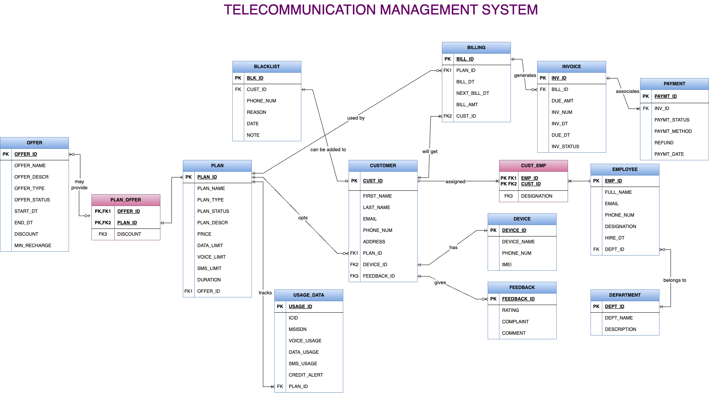
Entity Relationship Diagram

Slide 7
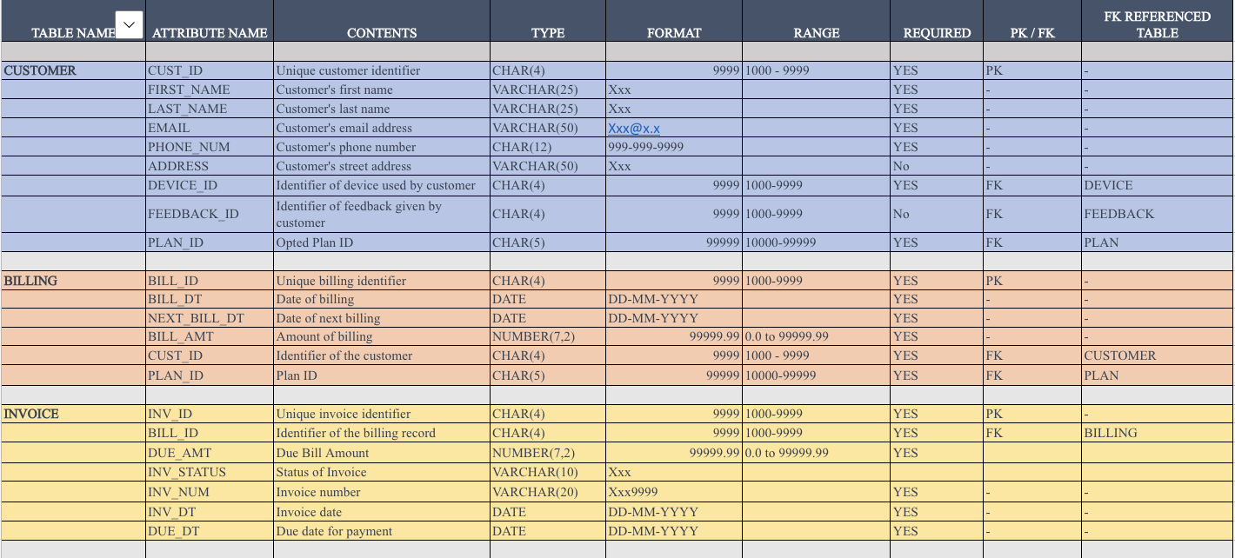
Data Dictionary

Slide 8
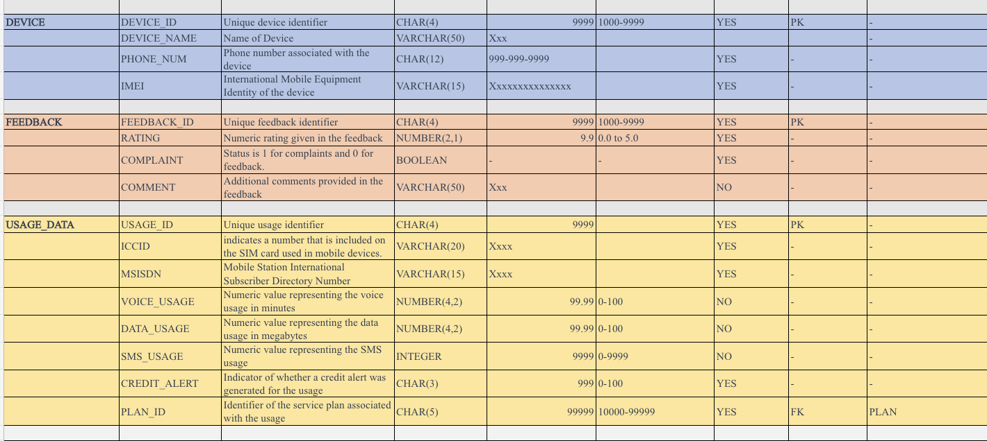

Slide 9
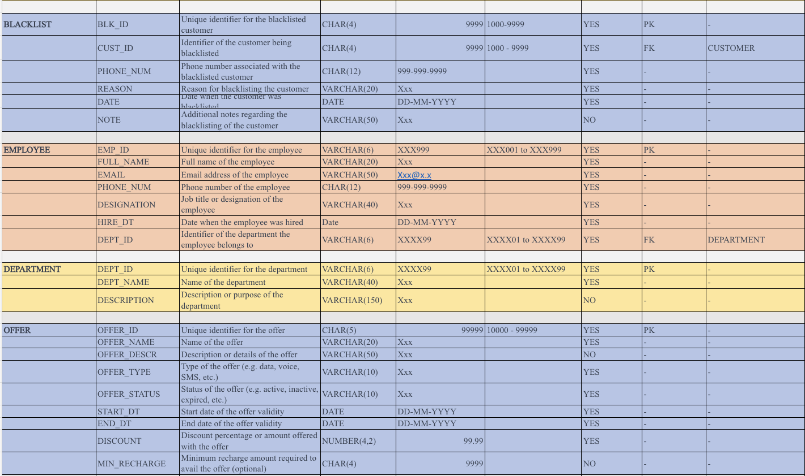

Slide 10
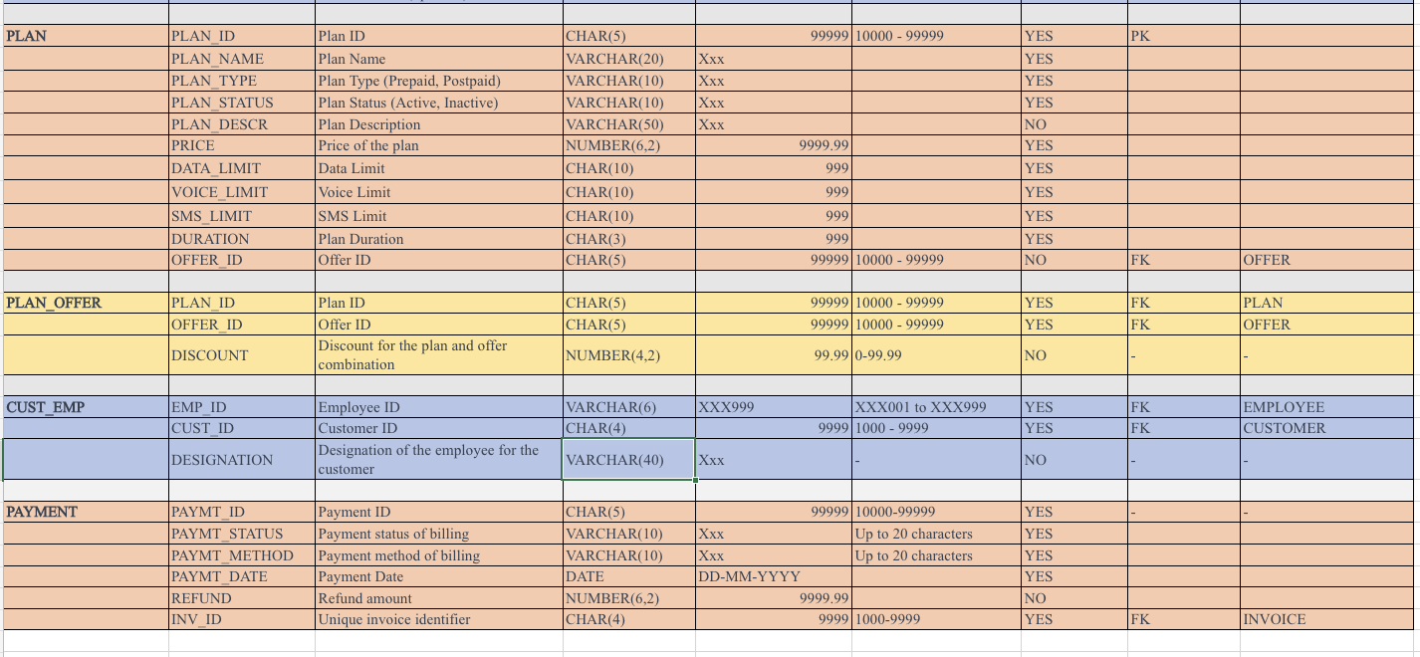
Data Dictionary: Group8_Data_Dictionary

Slide 11
Database & Tables Setup
Customer - It contains the information of customers
Billing - It is a summary of customer information and billing cycle information
Invoice - It contains the information about the amount due for the invoice
Device - It includes details about associated devices to users.
Feedback - It has information about customer’s feedback and complaints
Blacklist - It lists customers with above $500 in outstanding invoices, Also customer representatives can add manually.

Slide 12
Usage_Data - It has information about customers plan utilization over voice data and sms
Employee - It contains the information of the employees
Department - It includes information on the employees' department.
Offer - It includes details on offers made in regard to a plan.
Plan - It has information about available plans that customer can avail
Payment - It will maintain track of all payments done for an invoice
Plan_Offer - It is a composite entity storing id’s of plan and offer
Cust_Emp - It is a composite entity storing id’s of customer and employee

Slide 13
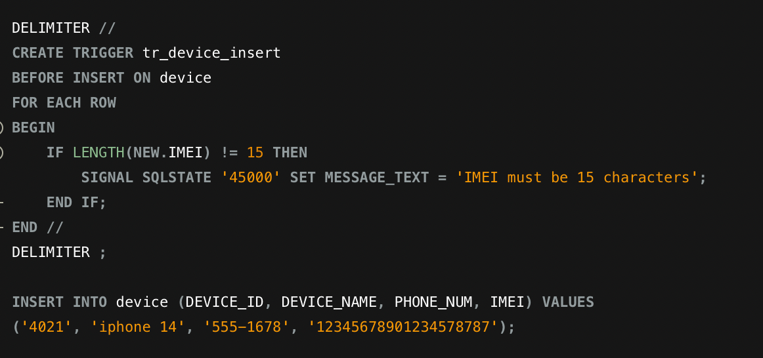
Trigger commands
1. For IMEI Validation.

Slide 14
Continued…
Output:
03:39:51 INSERT INTO device (DEVICE_ID, DEVICE_NAME, PHONE_NUM, IMEI) VALUES('4021', 'iPhone 14', '555-1678', '12345678901234578787') Error Code: 1406. Data too long for column 'IMEI' at row 1 0.0056 sec.
Explanation:
If a consumer or customer representative enters an IMEI number with more than 15 digits, the system will issue an error stating that the IMEI number is too long. This trigger command is more beneficial for avoiding duplicate data in a table.

Slide 15
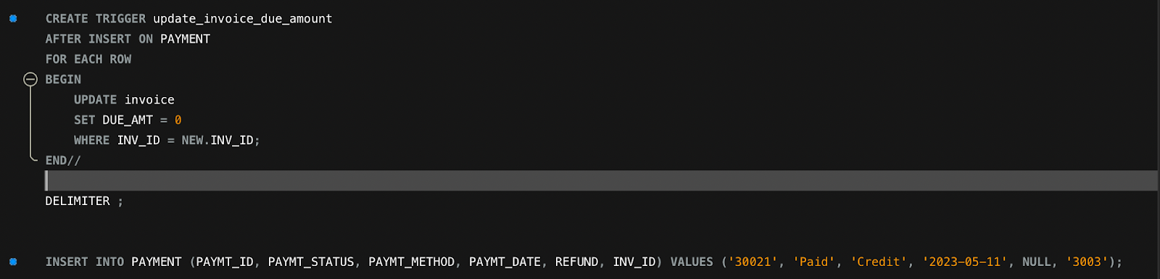
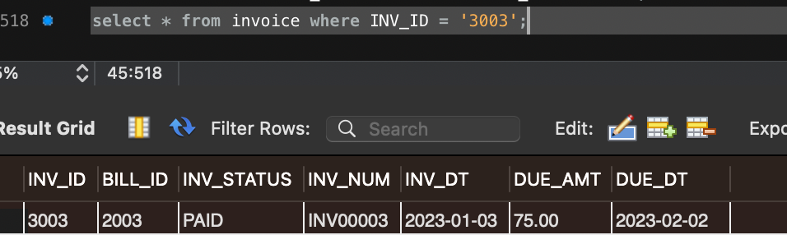
Payment Information Validation
2. Payment Information validation:
Here due amount is 75.00 as mentioned in the preceding table. This is due for invoice “3003”.

Slide 16
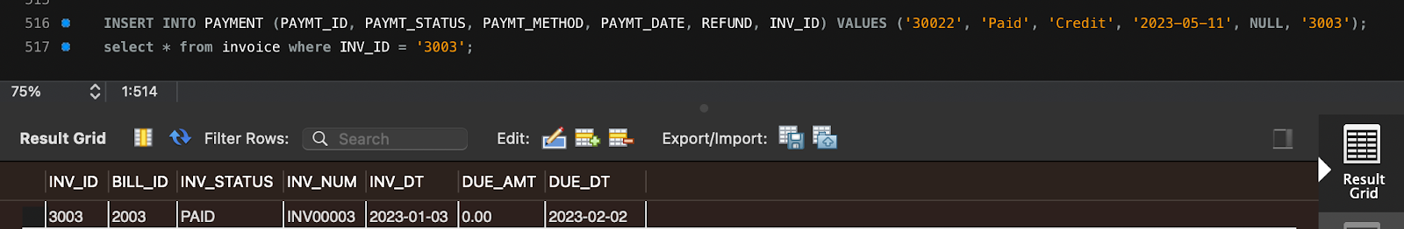
Continued…
Explanation:
We've created a trigger command that updates the due amount to zero in the invoice table whenever a new payment table entry is associated with an invoice. Once payment has been received and recorded in the payment table, this trigger command would help automate the process of revising the invoice status to paid.

Slide 17
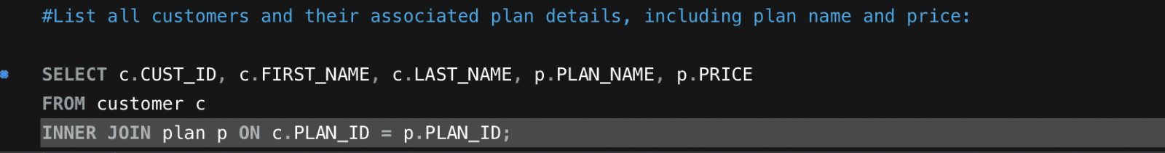
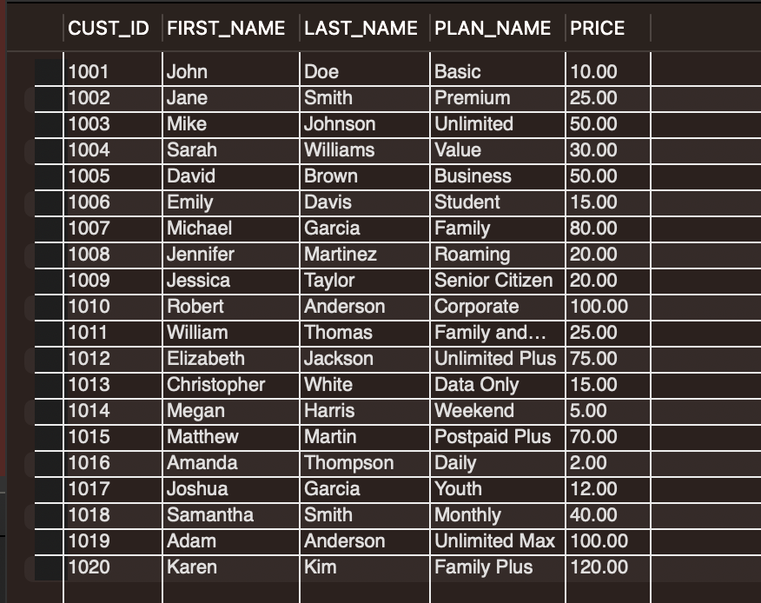
Data Retrieval Queries
List all customers and their associated plan details, including plan name and price.
This Query lists all active customers along with their associated plan information, including plan name, price, and customer name.

Slide 18
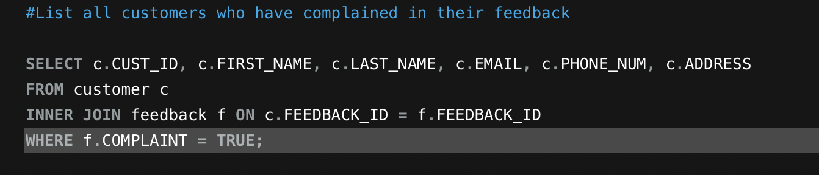
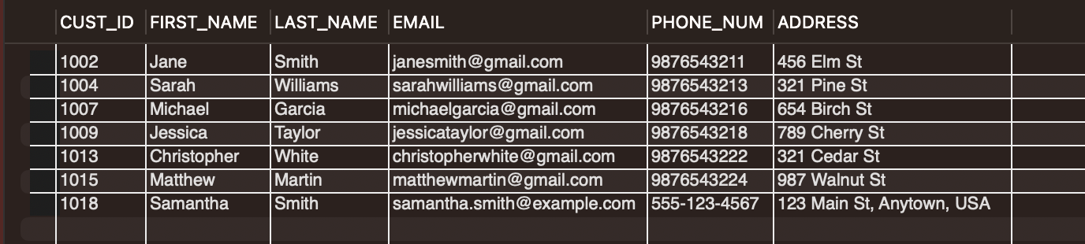
List all customers who have complained in their feedback
This query will display all customers who have filed a complaint regarding their telecommunication management system-provided services.

Slide 19
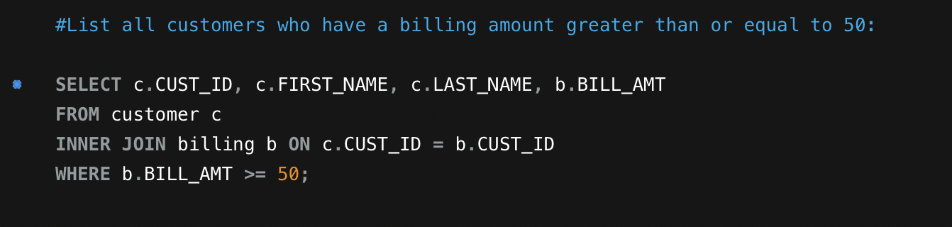
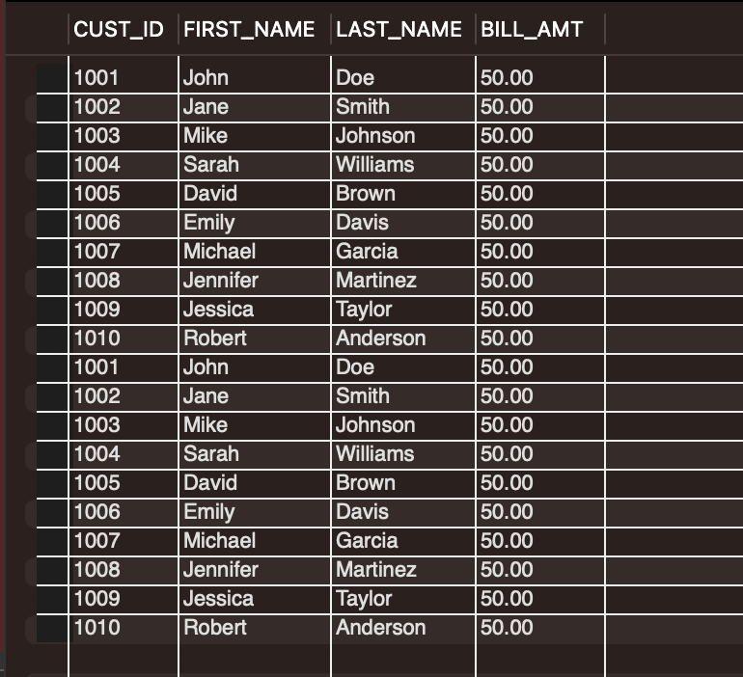
List all customers who have a billing amount greater than or equal to 50
This provides details about customers whose invoicing amount is at least 50.

Slide 20
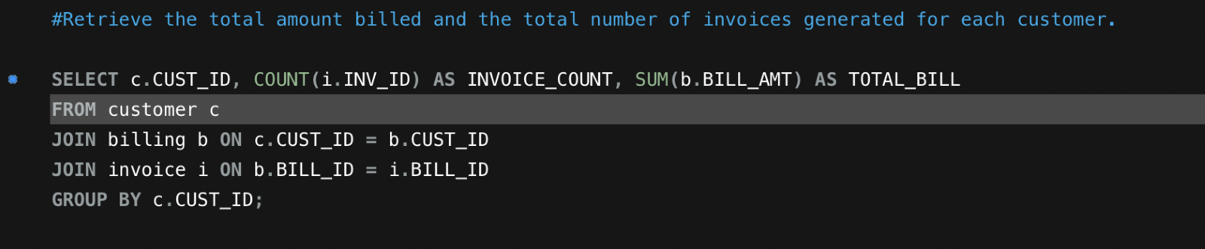
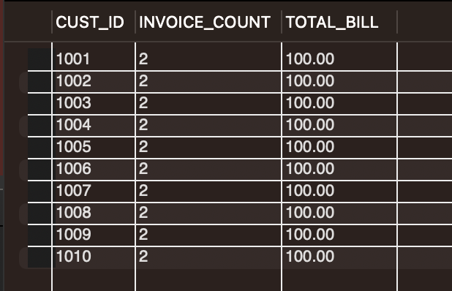
Retrieve the total amount billed and the total number of invoices generated for each customer.
It includes the customer's number of invoices and total outstanding balance.

Slide 21
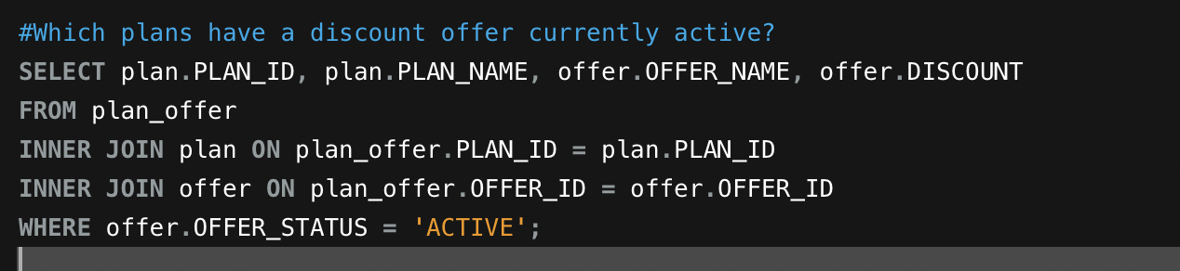
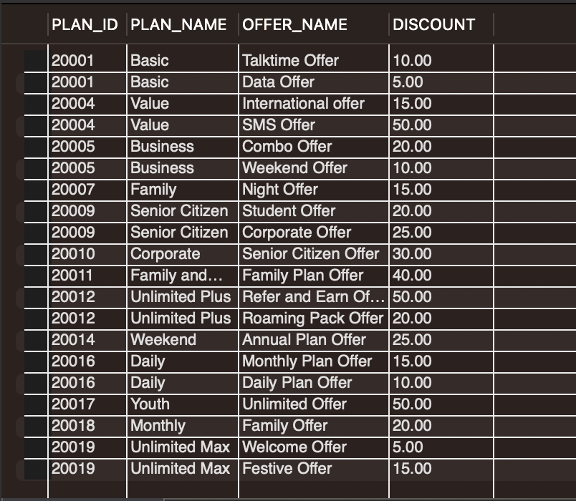
Which plans have a discount offer currently active?
It contains information about the client who took advantage of the discount offered by the telecommunications provider.

Slide 22
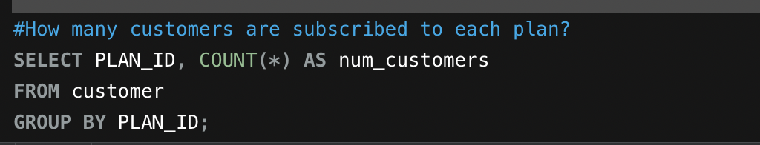
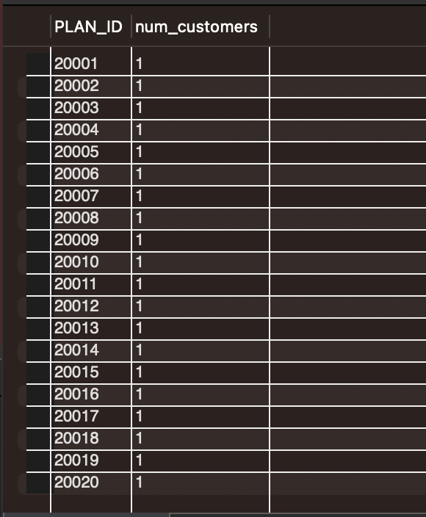
How many customers subscribe to each plan?
It contains information about the number of customers who have signed up for each plan.

Slide 23
Future Scope
The application of blockchain technology to data security, data integrity, and data privacy is possible. Additionally, it provides a clear record of all activity.
Customers can use mobile applications to view their daily or monthly telecommunications service usage and to purchase new plans directly from the application.
In addition, based on their Usage and activity patterns, we can provide them with a more effective future. This section is primarily about Machine Learning.
The database can be linked to third-party services such as Netflix and Amazon to provide customers with improved plan options. This means that consumers can purchase a plan that includes these benefits.
Using middleware, other network provider companies can access a database, which is advantageous for both companies.
Currently, consumers can only pay for their plans with a credit card or cash, but in the future, we can introduce digital wallets as a payment option.

Slide 24
Conclusion
In conclusion, a database system for telecommunications is essential for the efficient management of a telecommunications company. It facilitates the storage and administration of enormous quantities of consumer, service, billing, and usage data. It contains information about available plans, offers, consumption, bills, and past-due invoices, and can be used to purchase and modify service plans. In addition, it enables network providers to efficiently manage each customer's billing cycle, payments, reported complaints, and blacklist.

Slide 25
THANK YOU !

